Slide 1
Analyzing STOPS results through the lens of Infographics
Amar Sarvepalli WSP
Rhett Fussell
WSP

Slide 2
What’s the Motivation?

Slide 3
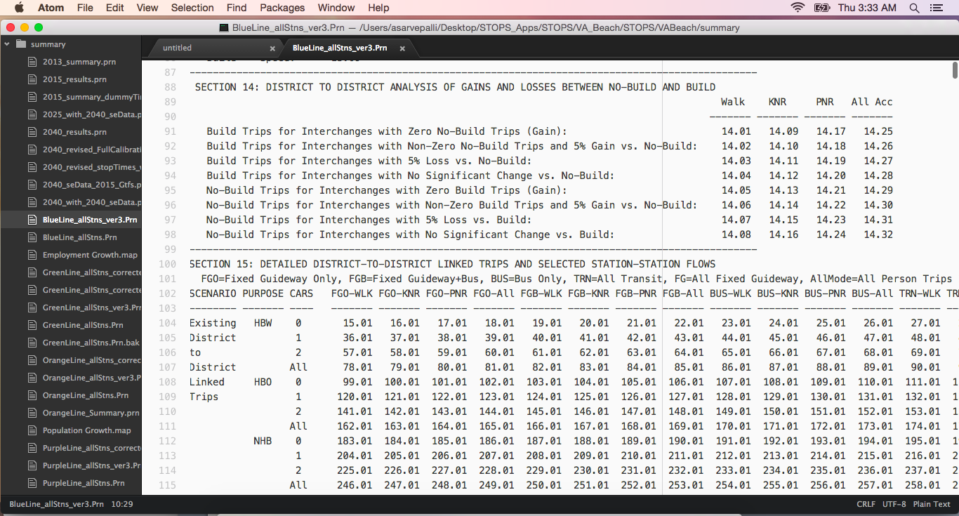
Why?
Over 1,000 tables
Well….let’s take a look at STOPS report
4 horizon years X N alternatives = Tens of report files
Notes:
To be precise there are about 1022 tables. Most of the times user look at 47 of those tables.

Slide 4
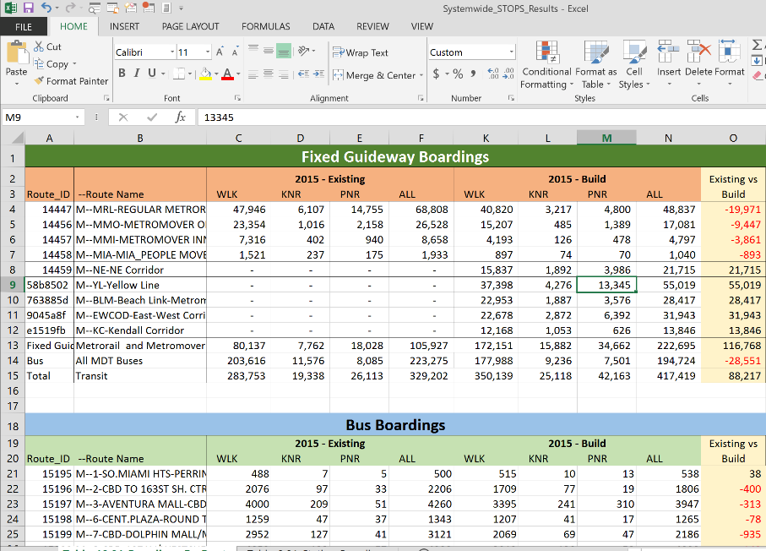
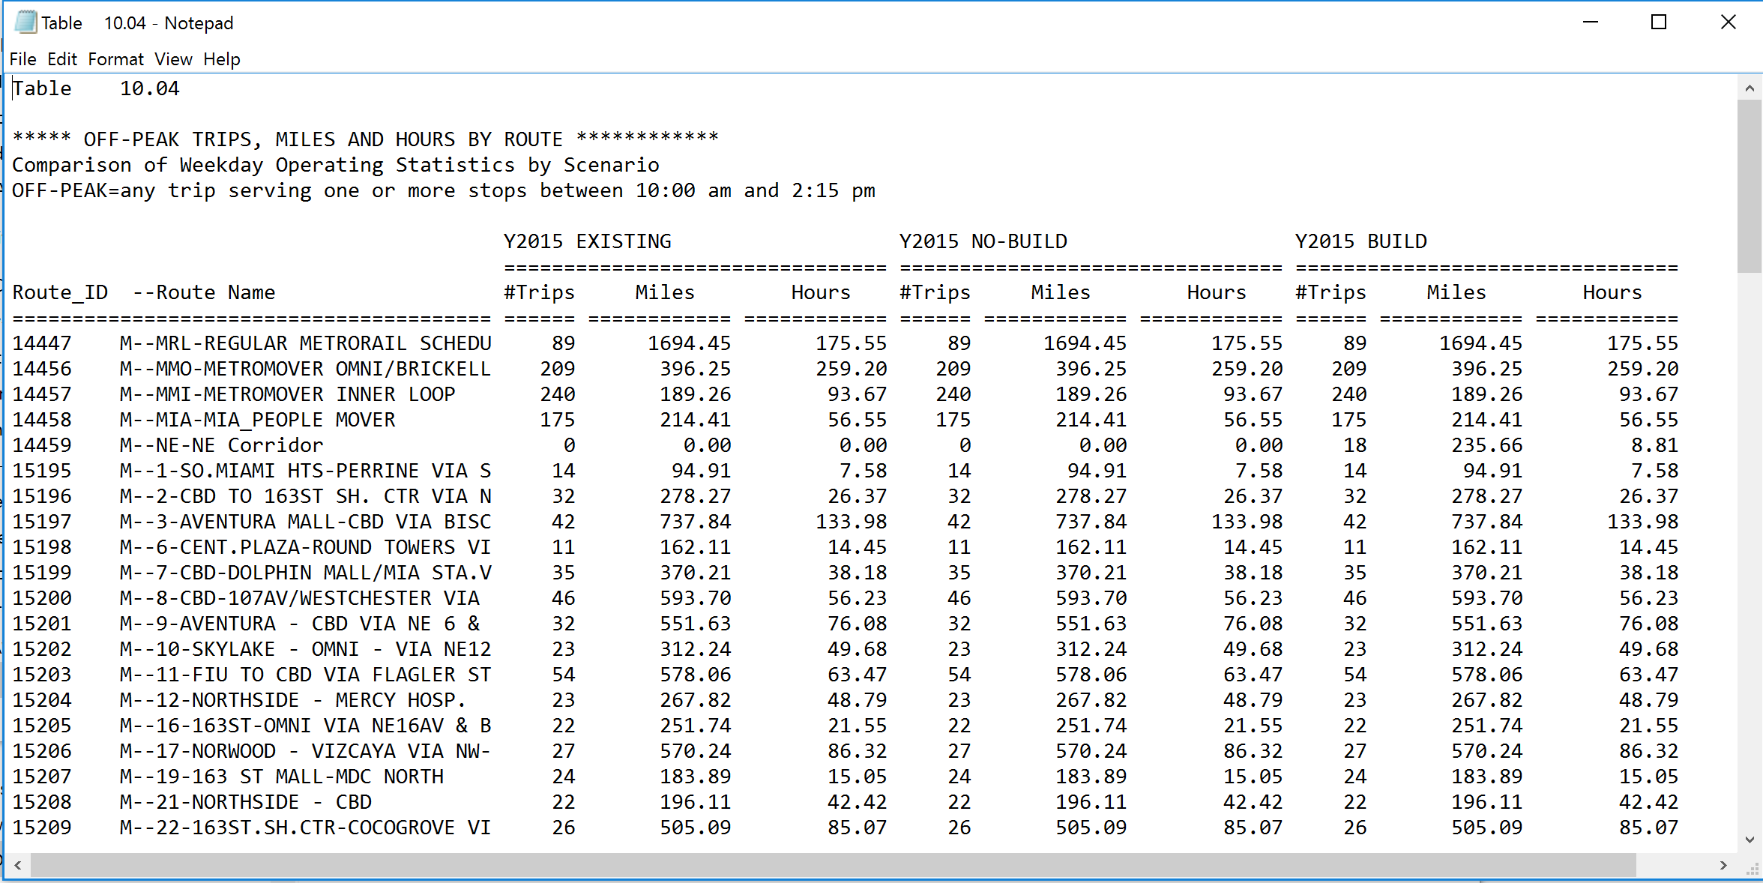
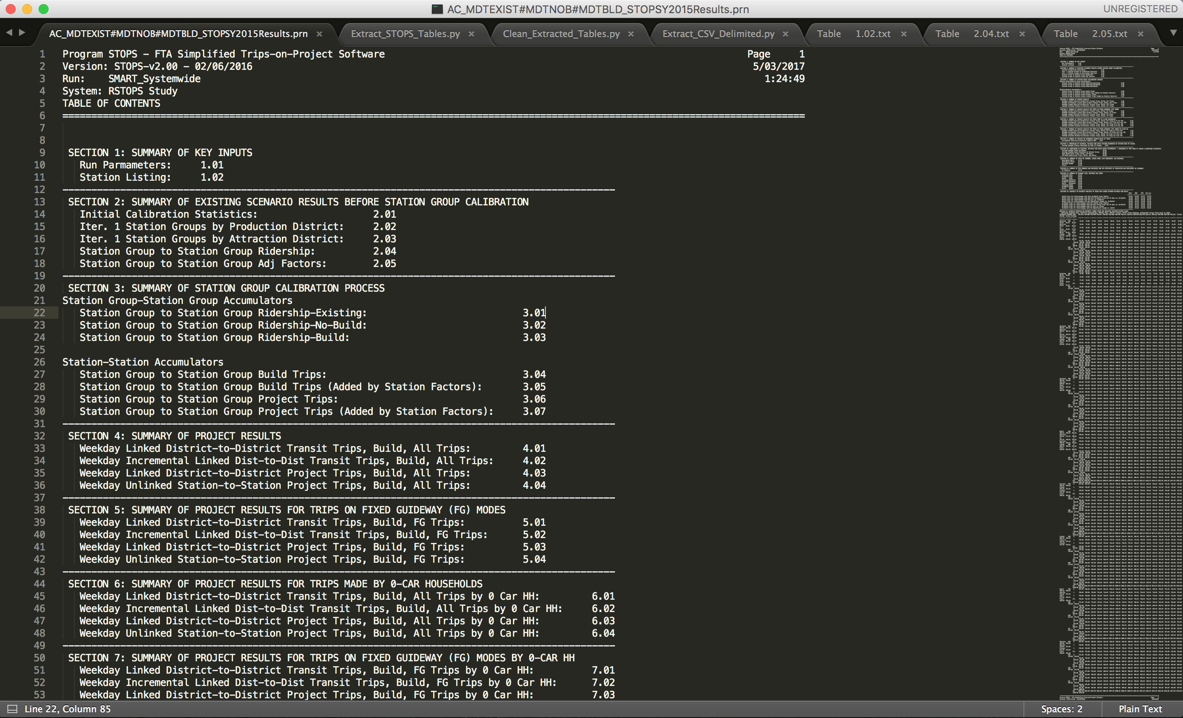
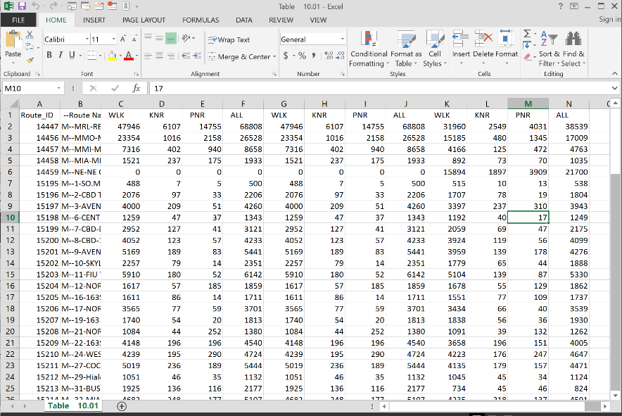
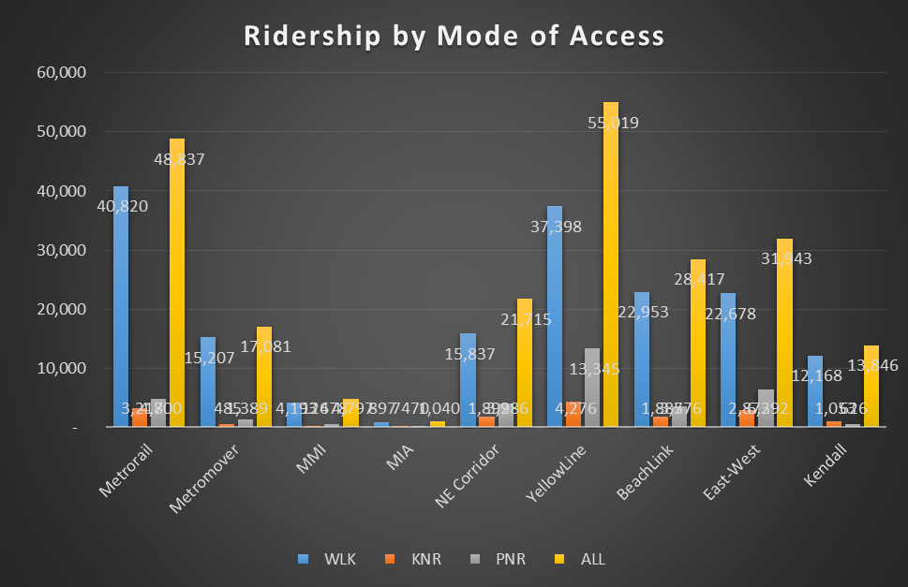
Motivation in doing this ?
Typical Steps in processing STOPS results
Find desired tables: Scroll through hundreds of lines
Copy to Excel: to convert into column data (table)
Summarize data
Format tables
Create charts / plots
Not 1,000 tables but let’s say 20 tables
20 Tables X 4 horizon years X 5 Alternatives
For one chart:
4 transformations
10 - 15 mins
Not reproducible
Notes:
Basically scroll through millions of lines of text to search desired tables and then copy them to excel and then do text to columns formatting to start analyzing results
Imagine doing this for tens of reports for tens of alternatives --

Slide 5
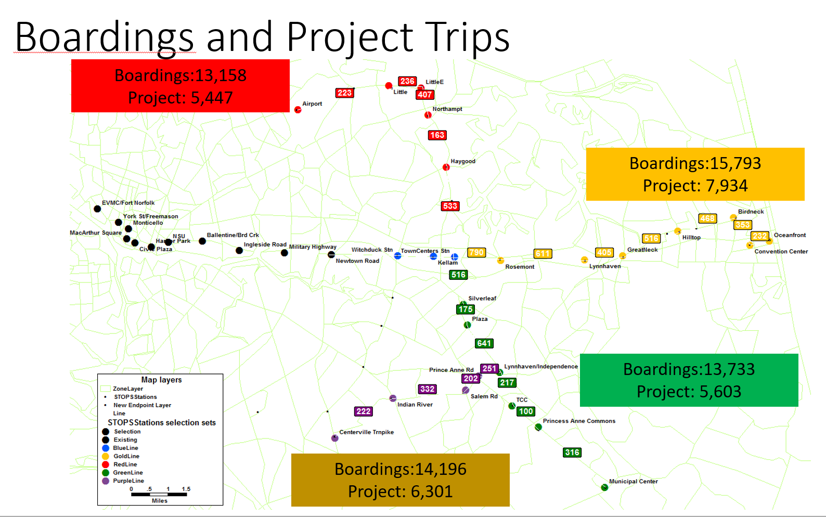
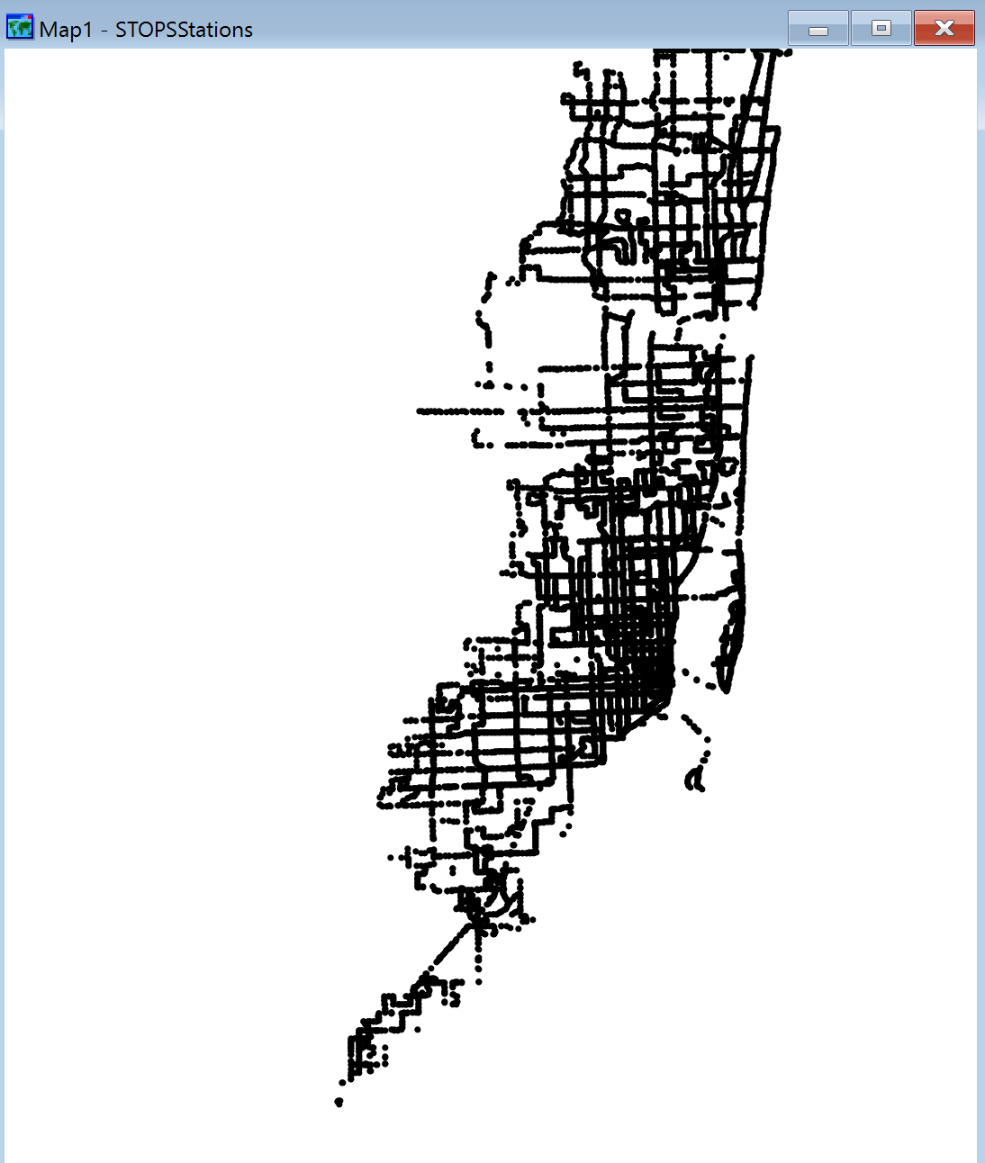
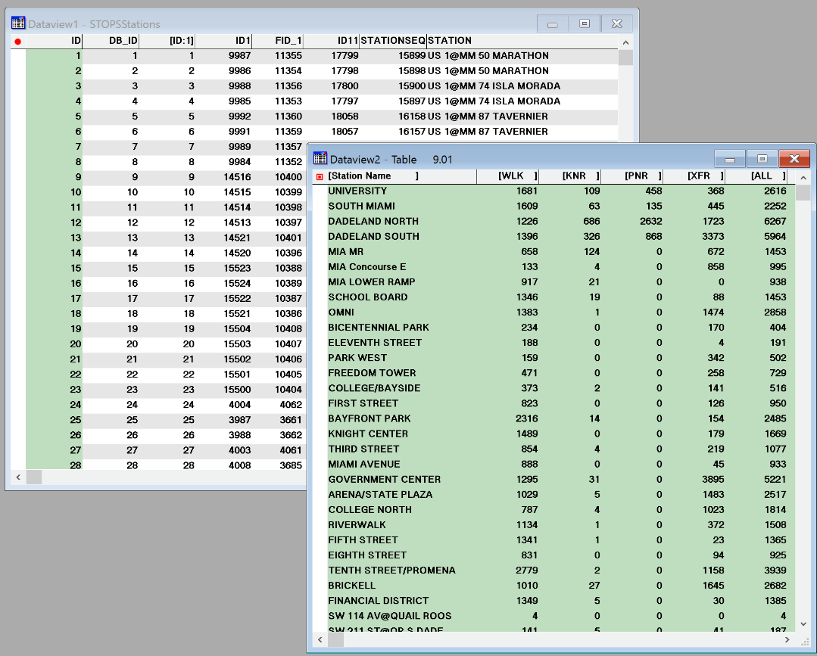
Motivation in doing this ?
Typical Steps in processing STOPS results
Import data to ArcGIS or TransCAD to produce maps
Create maps to analyze ridership by stops and routes
Save as jpegs or pdf
Word Document or PPT (to tell a story)
Import tables, charts, plots from excel
Maps and thematic for ArcGIS
Probably 1- 3 Maps ?
1 Map X 4 horizon years X 5 Alternatives
Notes:
Basically scroll through millions of lines of text to search desired tables and then copy them to excel and then do text to columns formatting to start analyzing results

Slide 6
Custom Tool Requirements

Slide 7
Wish list !!!!
An Automated Custom Tool to do:
Snapshot of the run (inputs, outputs, adj factors)
Export Tables to CSV format
Produce basic graphs (bar charts comparing boardings at Fixed Guideway Stations )
Produce maps with ridership data at new / project stations
Generate District to district thematic (desire lines by districts on a map)
A Dashboard with high level summaries
Text parsing is easy and can be done quickly
How to do graphs?
Once done how to display?

Slide 8
Infographics

Slide 9
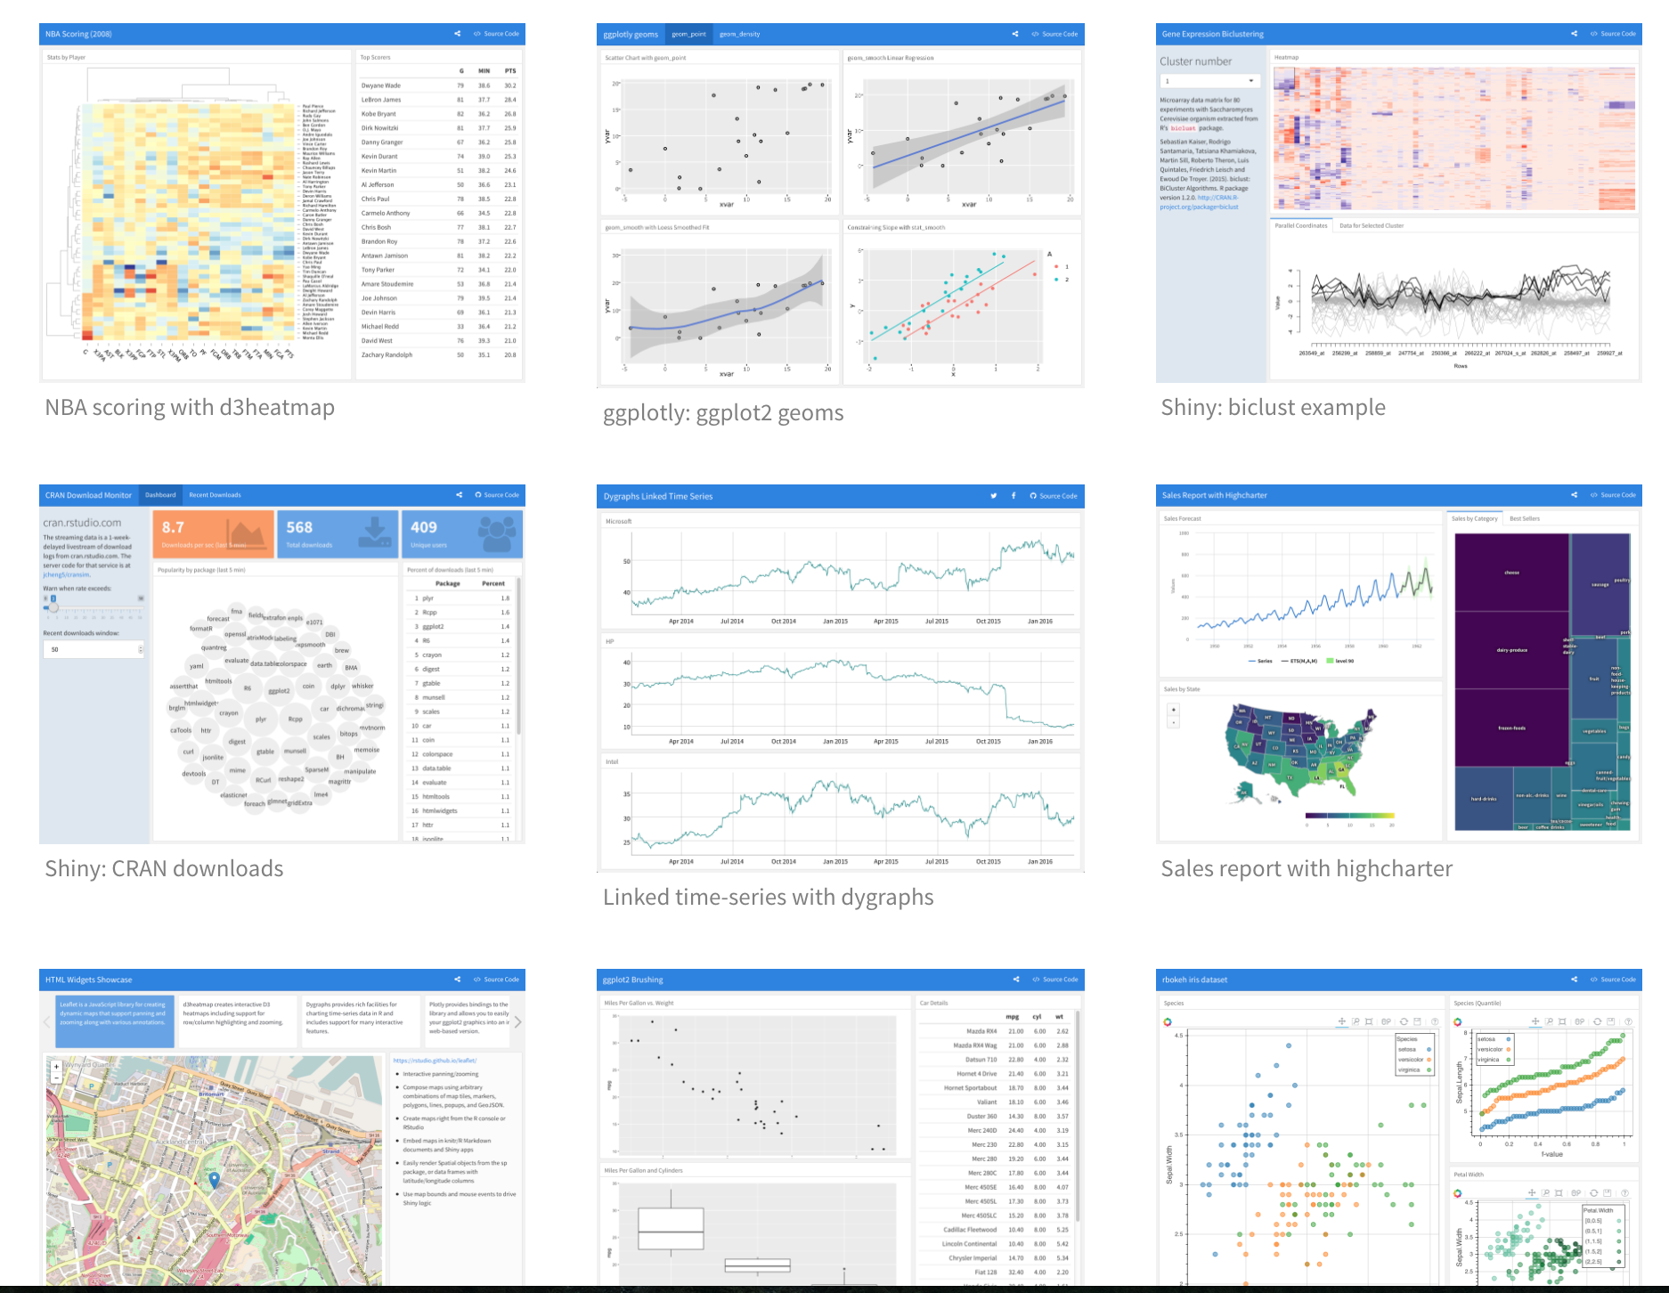
Visualization Techniques
InfoGraphics :
Not just simple visualizations
Interactive graphs to tell a story
Data Driven Documents (D3):
D3 allows you to bind arbitrary data to a Document Object Model (DOM), and then apply data-driven transformations to the document.
Independent Format (Html or IOSlides):
Scalable Graphics (SVG for Maps)
Static Documents: HTML,pdf, word, beamer
Static Presentations: IOSlides, slidy
Web based (static & dynamic): markdown (md), html-widgets,

Slide 10
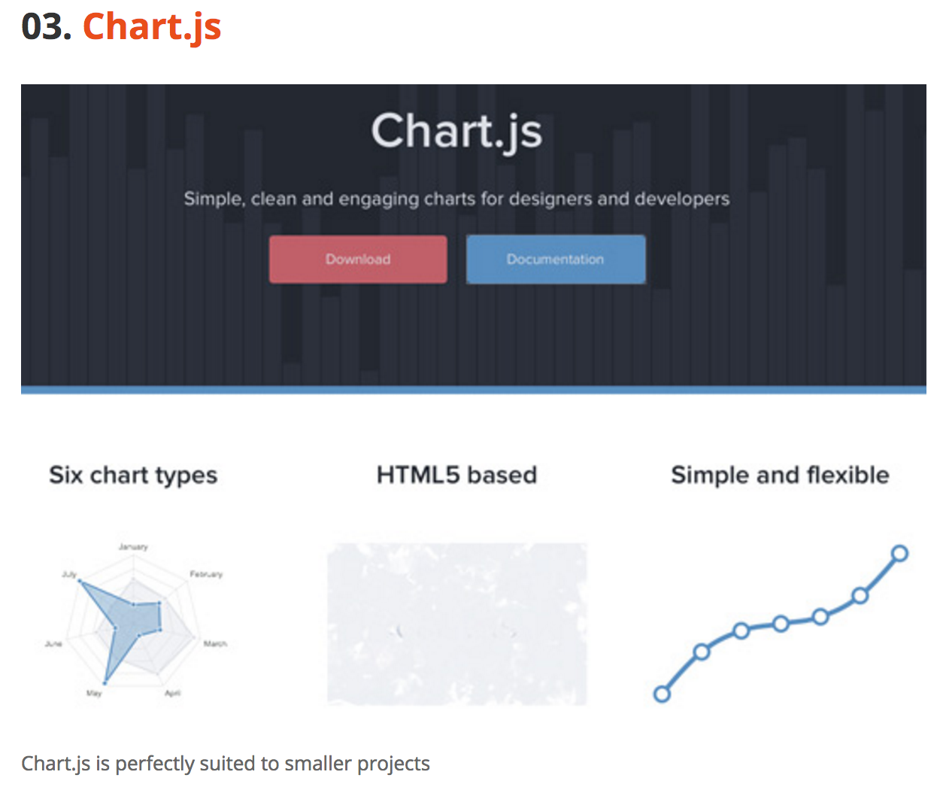





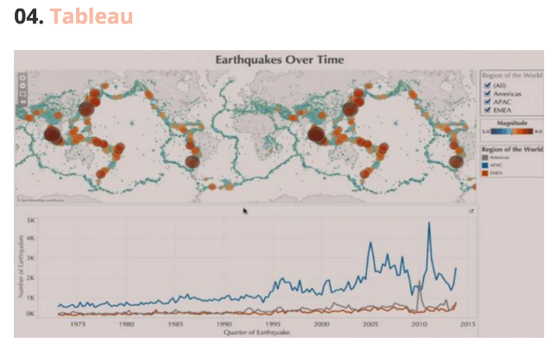

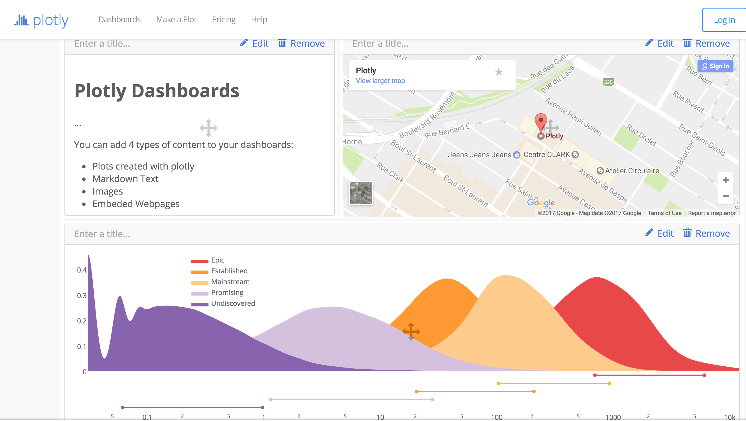
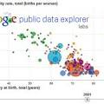



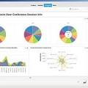
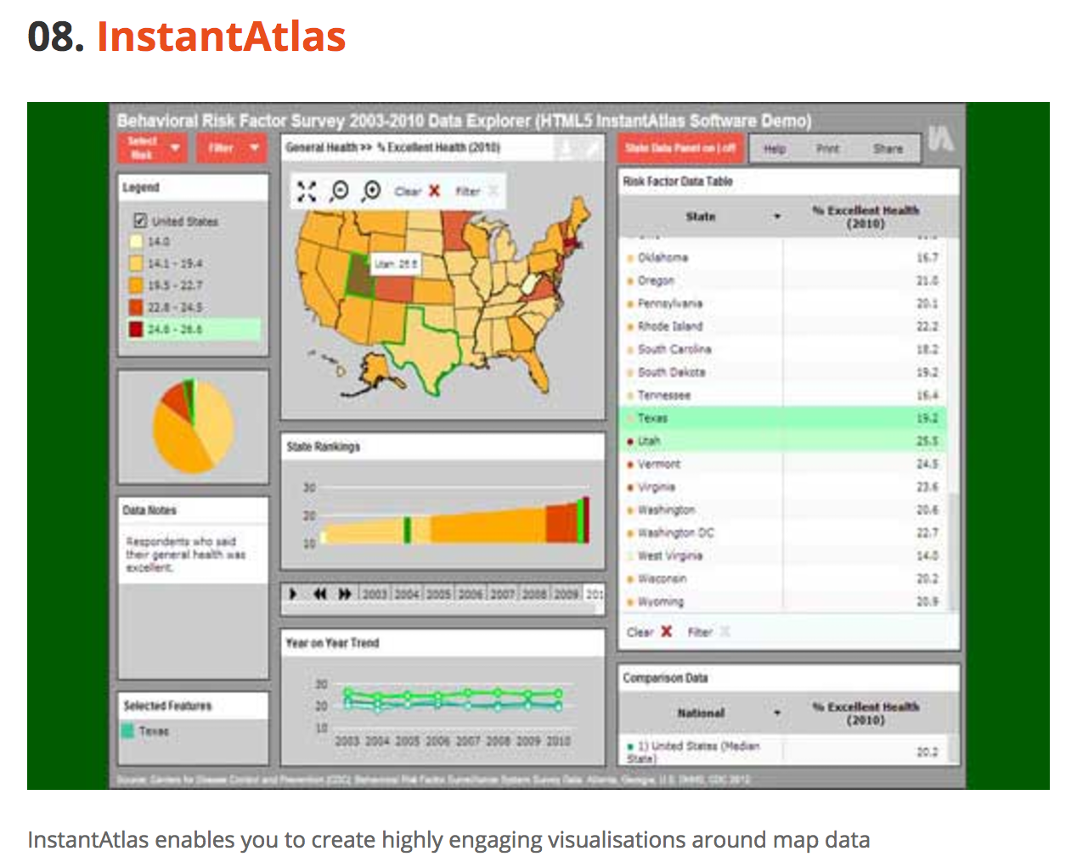




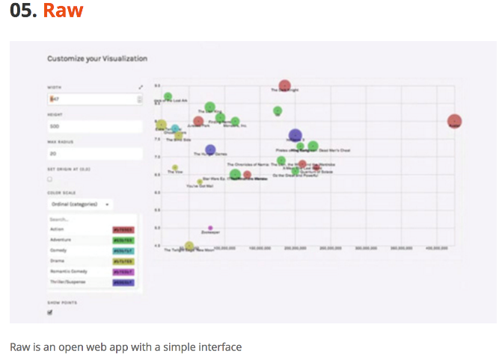
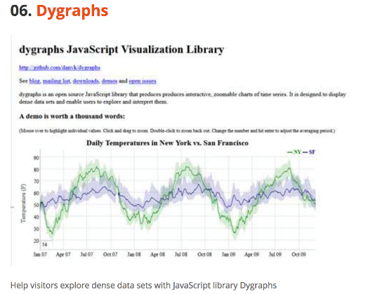

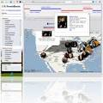
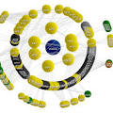

What Software to Use
How to Choose:
Open Software (freeware)
Easy to install across platforms
More common so that others can contribute
Outputs formats should be portable and should not require special views
Most commonly used IDE is R, Python, D3, JavaScript

Slide 11
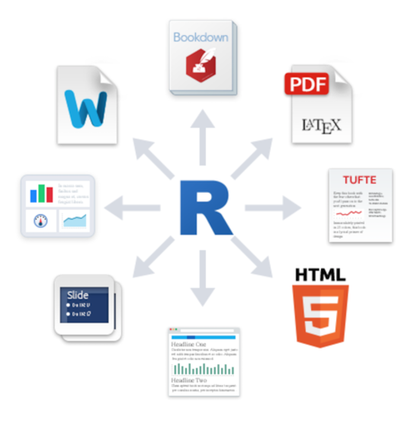
R & RStudio
Open Software
Hundreds of lightweight Apps
Tech industry support: Google’s BigQuery, Apple SWIFT, Rstudio rmarkdown
Tight Integration between Programing languages and Visulaizations
R Stuido IDE supports programing languages suchas: R, Python, Scala, SQL with in rMarkDown and rNotebook Tools which are used to develop D3.
Python IDE support ipython note books
Inputs:
Not limited by any formats (CSV, text, map, databases: SQL, NOSQL)
Third Party Plugins
Leaflet, Plotly, dygraphs, rbokeh, Highcharter, visNetwork and many others
Inputs
Source: http://rmarkdown.rstudio.com/lesson-13.html

Slide 12
Custom Tool

Slide 13
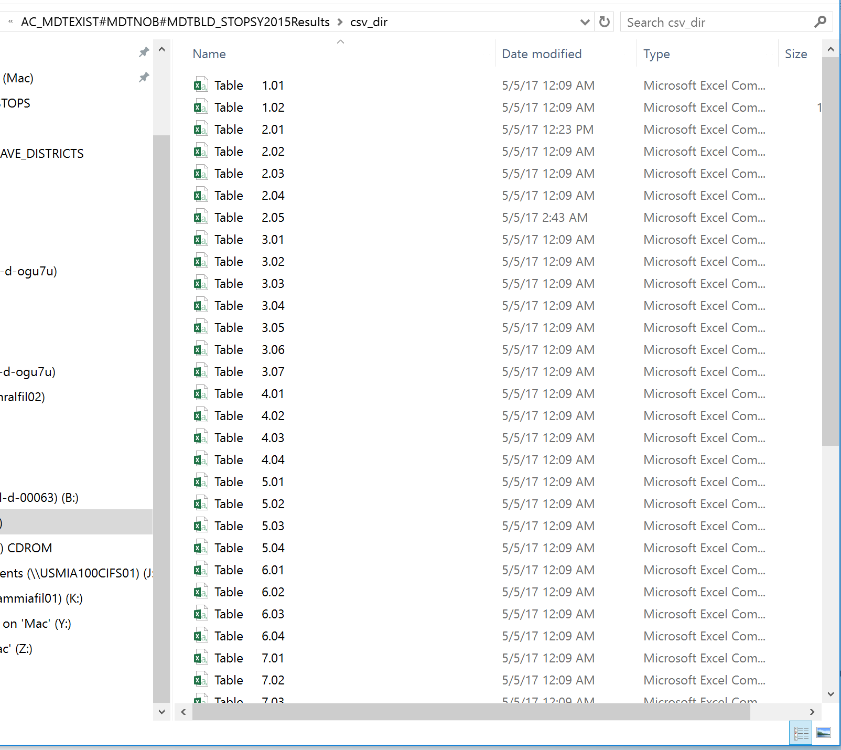
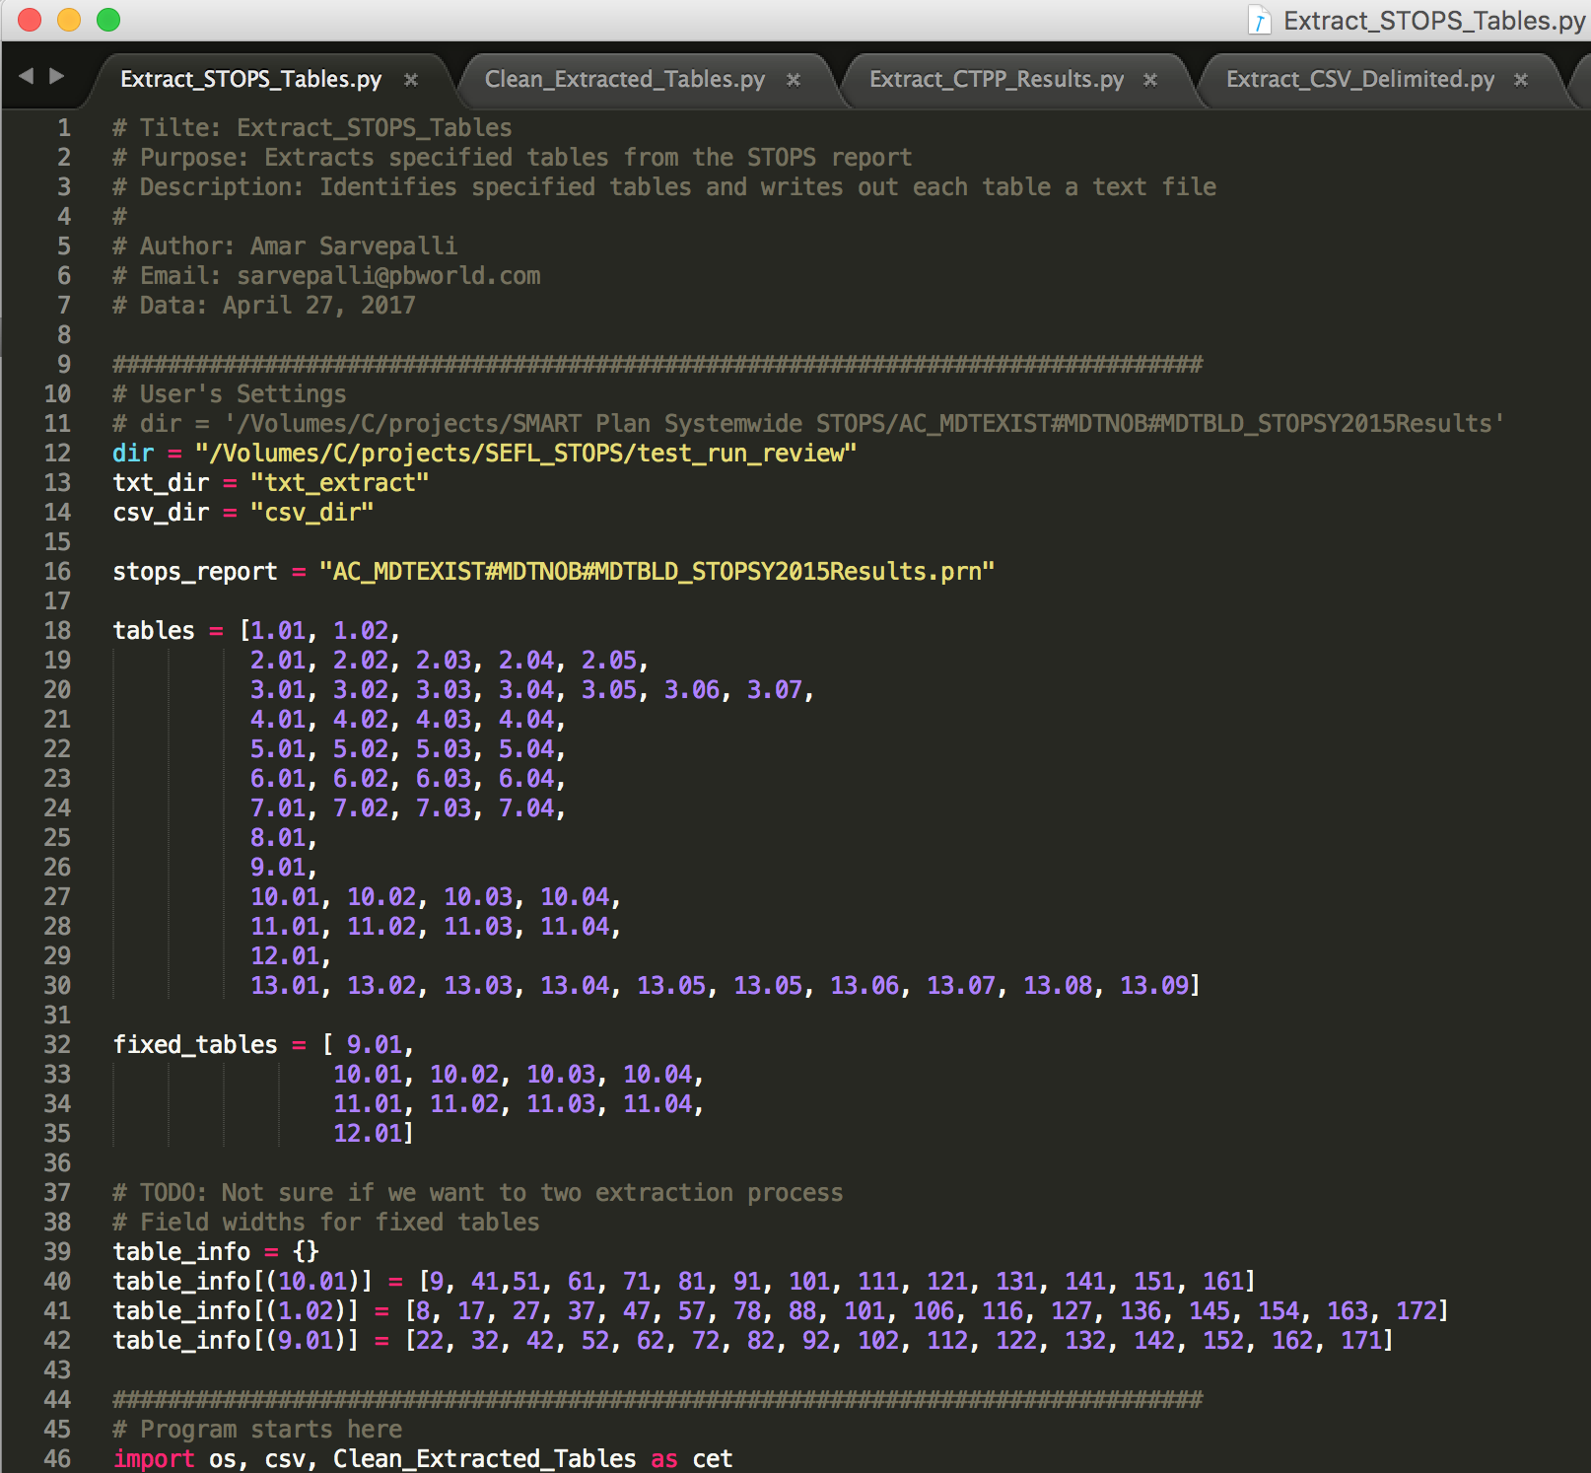
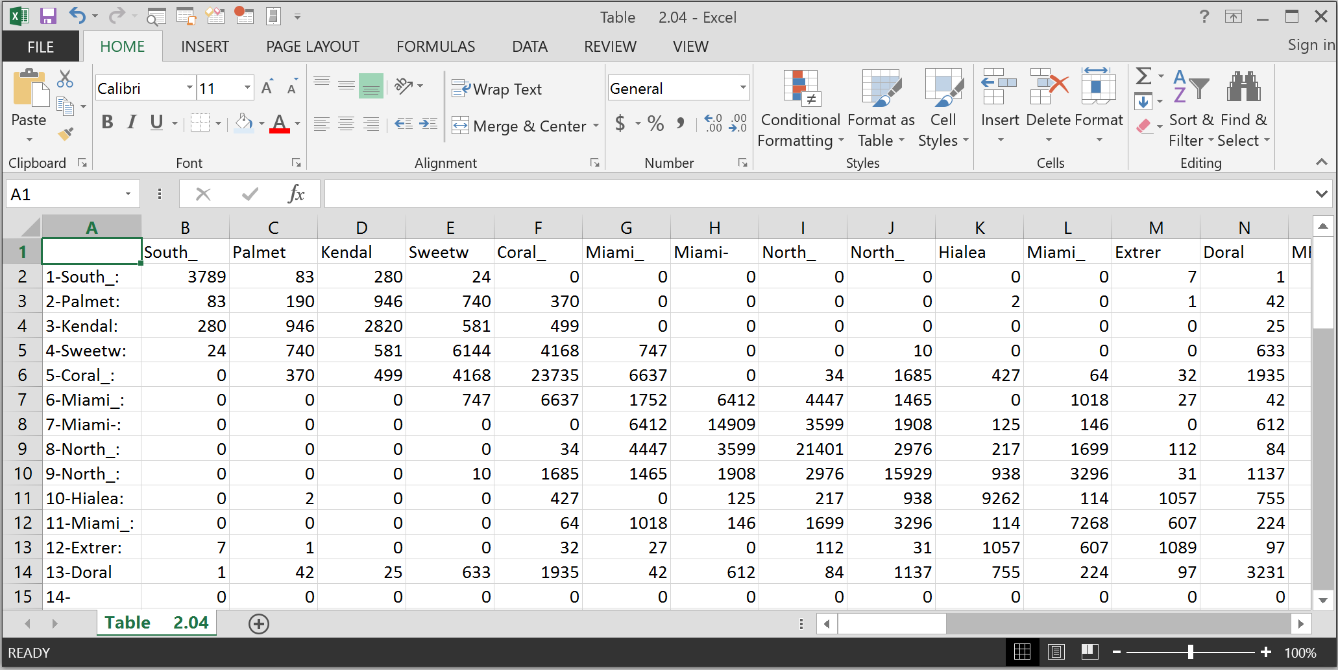
Extract Tables

Slide 14
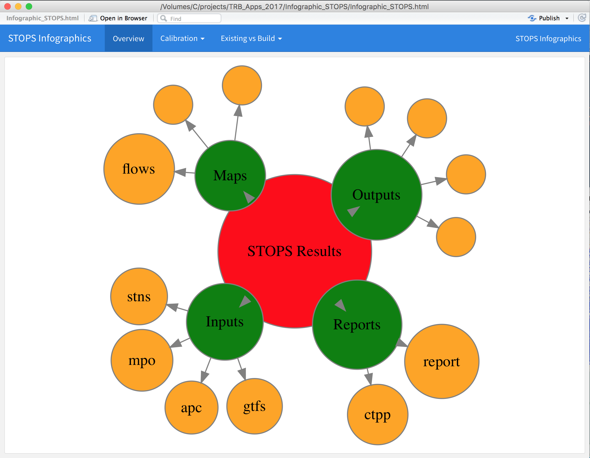
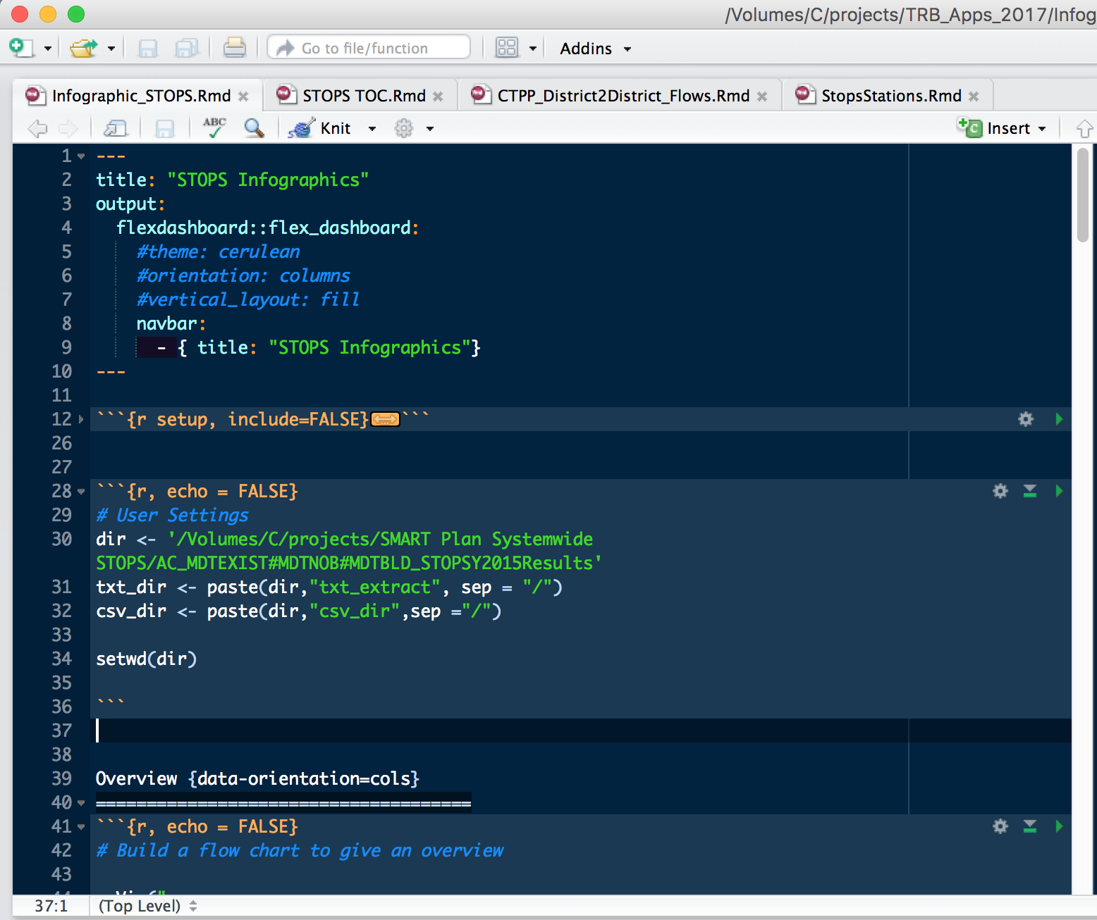
Interactive Flow Chart
CSV formatted tables

Slide 15
Github link
https://github.com/pbsag/STOPS_InfoGraphics

Slide 16
Demo

Slide 17
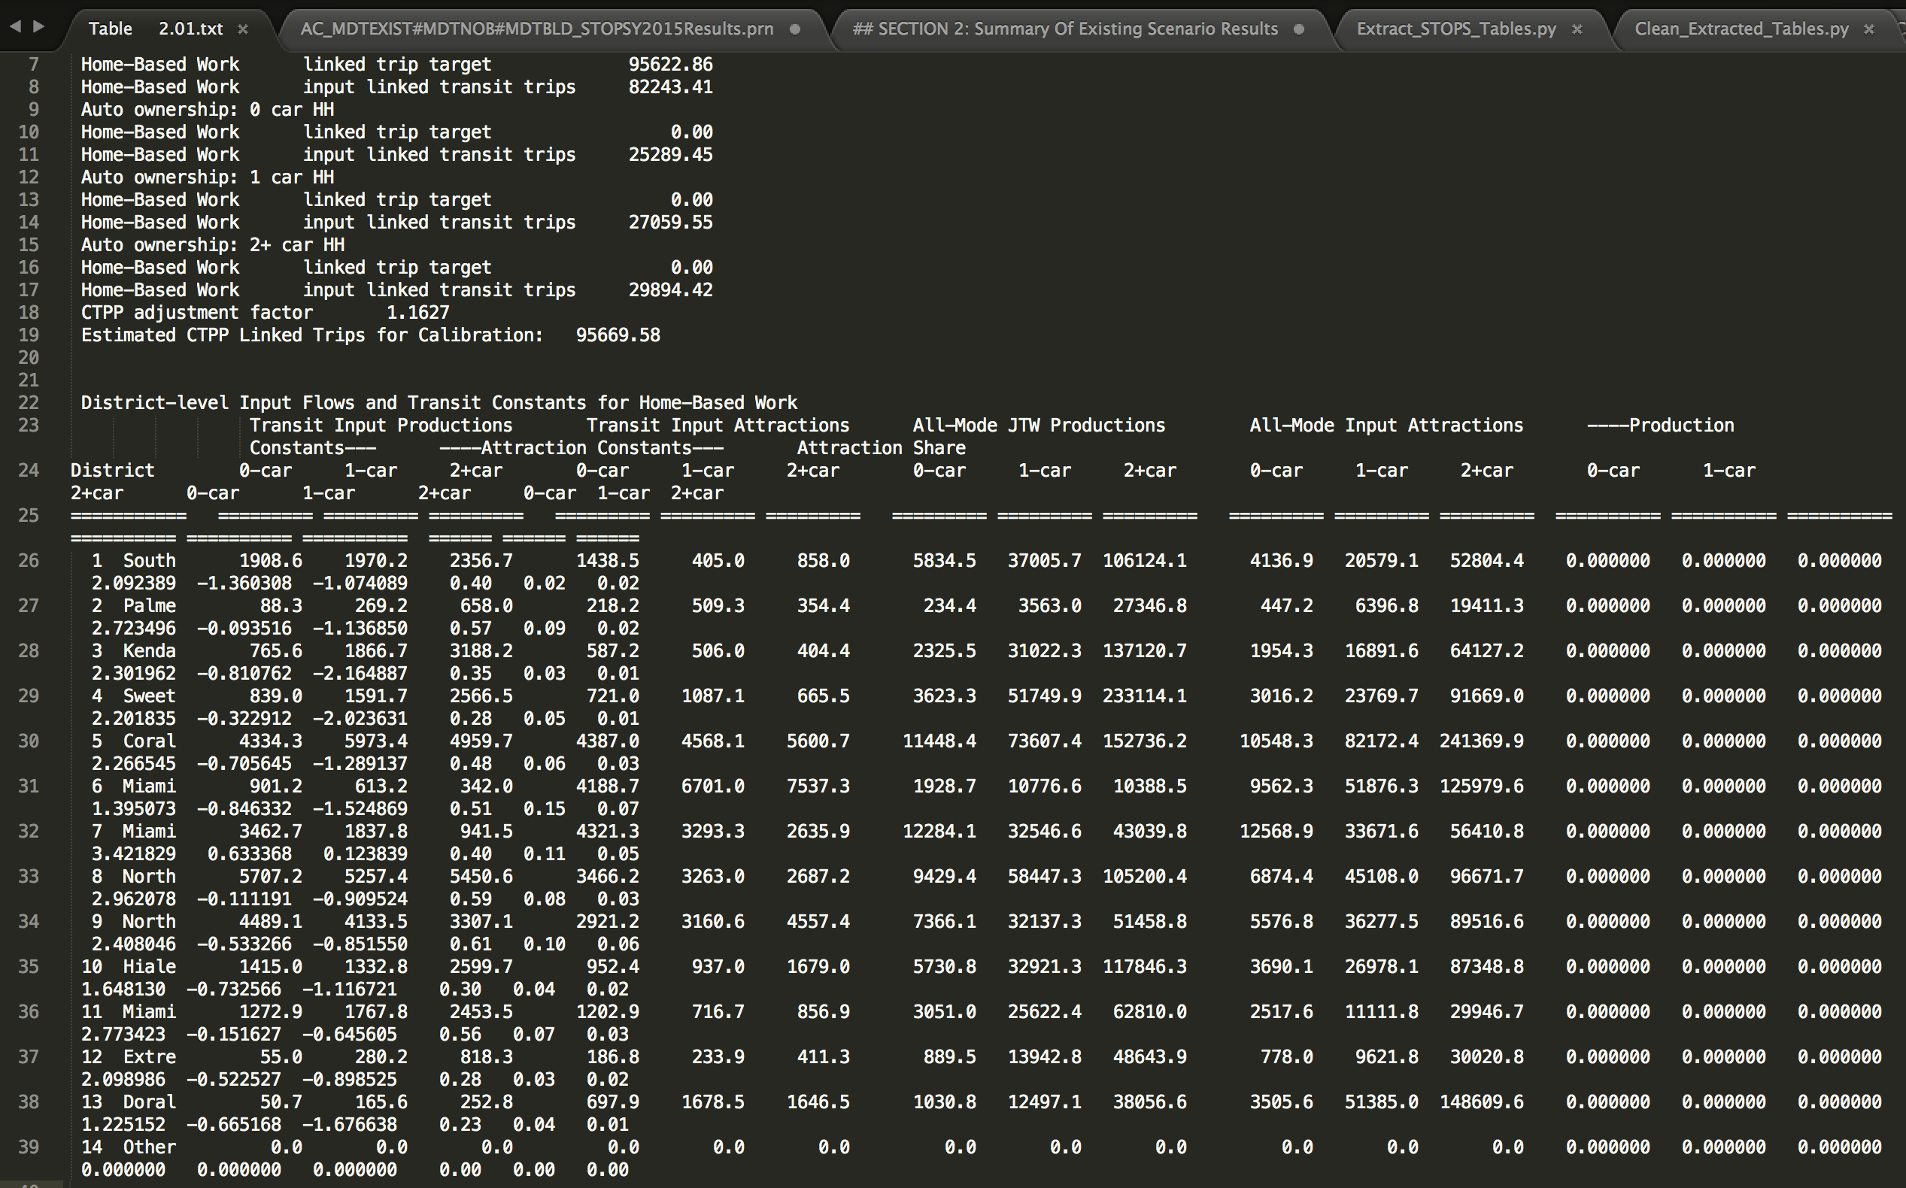
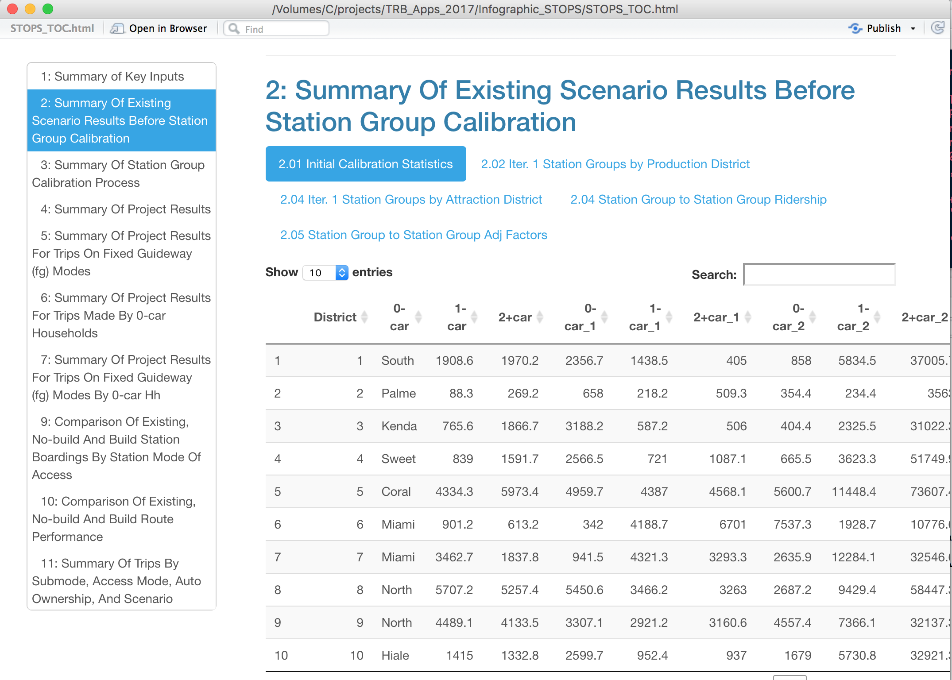
Interactive STOPS Report
Standard STOPS Report
Interactive STOPS Report
Key Features:
Navigation (Hyperlinked Table of Contents)
Searchable and Confined Tables
Downloadable or Exportable
Multiple tabs to sectional tables
Easy to compare tables (Existing vs Build)

Slide 18
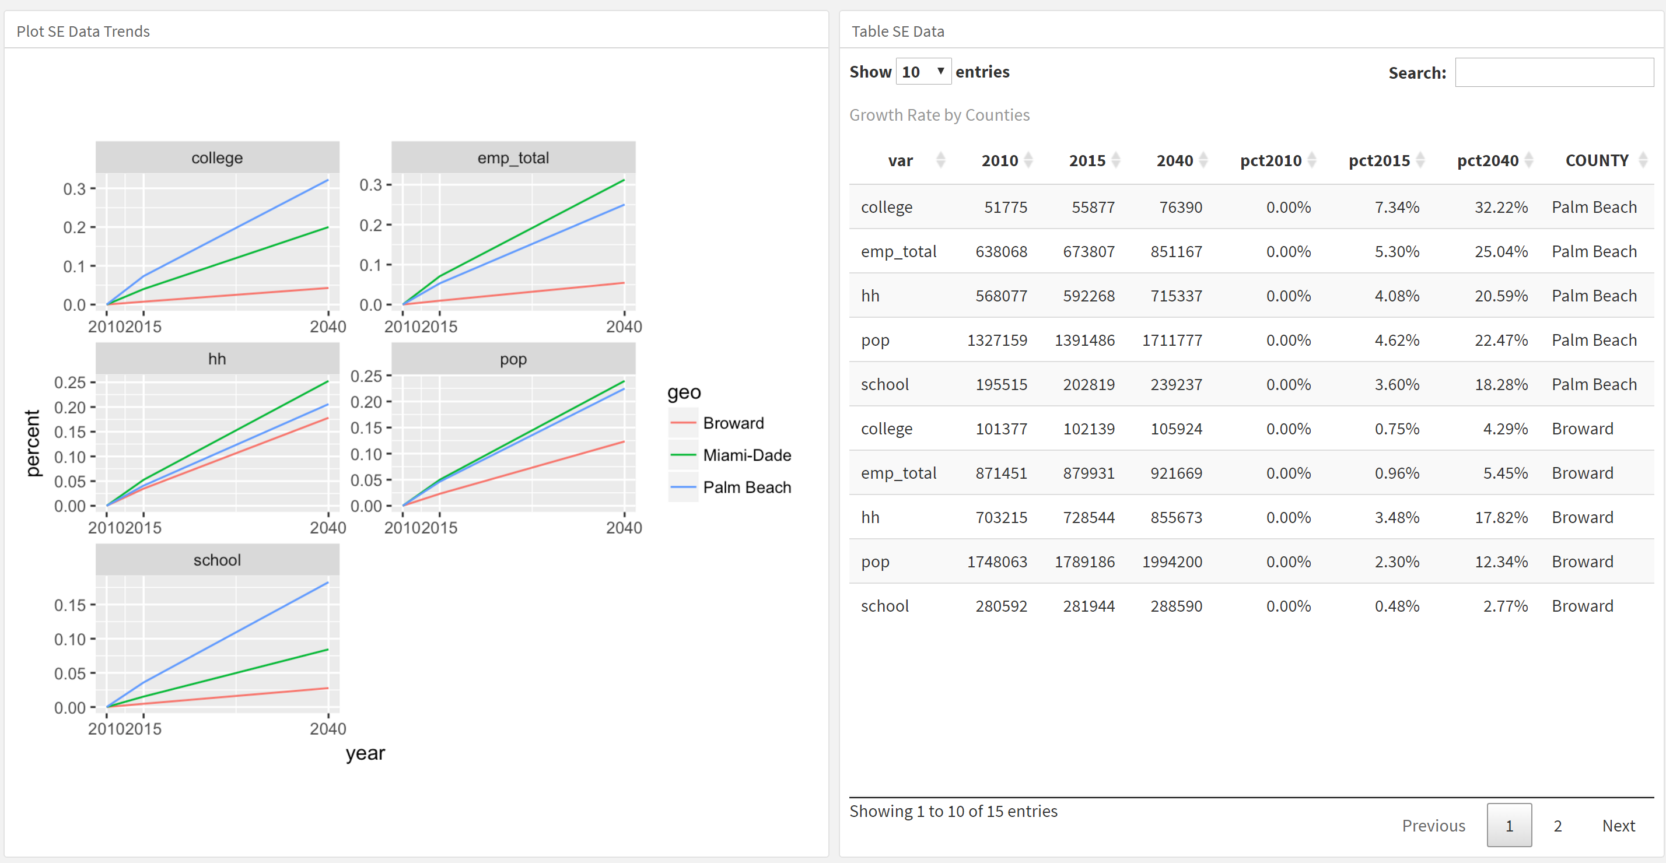
Linked Plots and Charts
Quickly narrow down outliers in through linked charts and tables

Slide 19
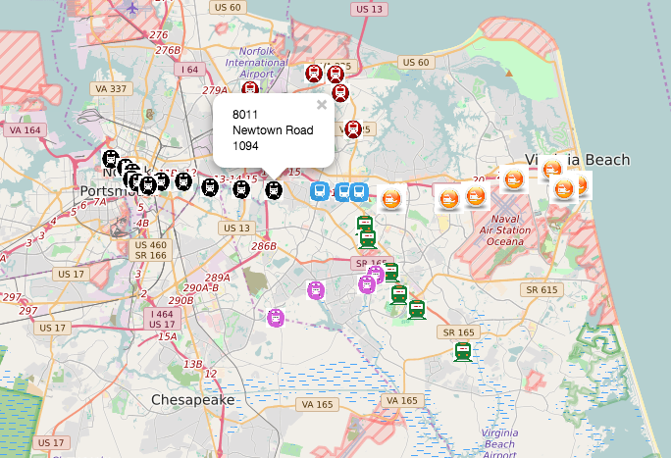
Scalable Maps
Interactive Stop Ridership
HTML format
Overlaying stops and ridership forecast with actual street network (OSM or Google) provides more information in analyzing the alternatives
No viewing software required
Small size and easy transportable
Opens on cross platform devices

Slide 20
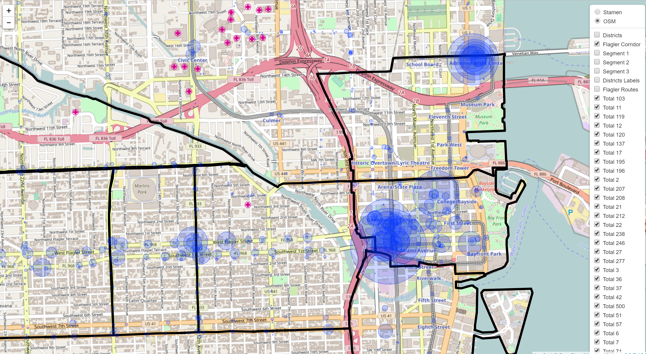
Scalable Maps
To display input data such as Stop level calibration targets (APC data)

Slide 21
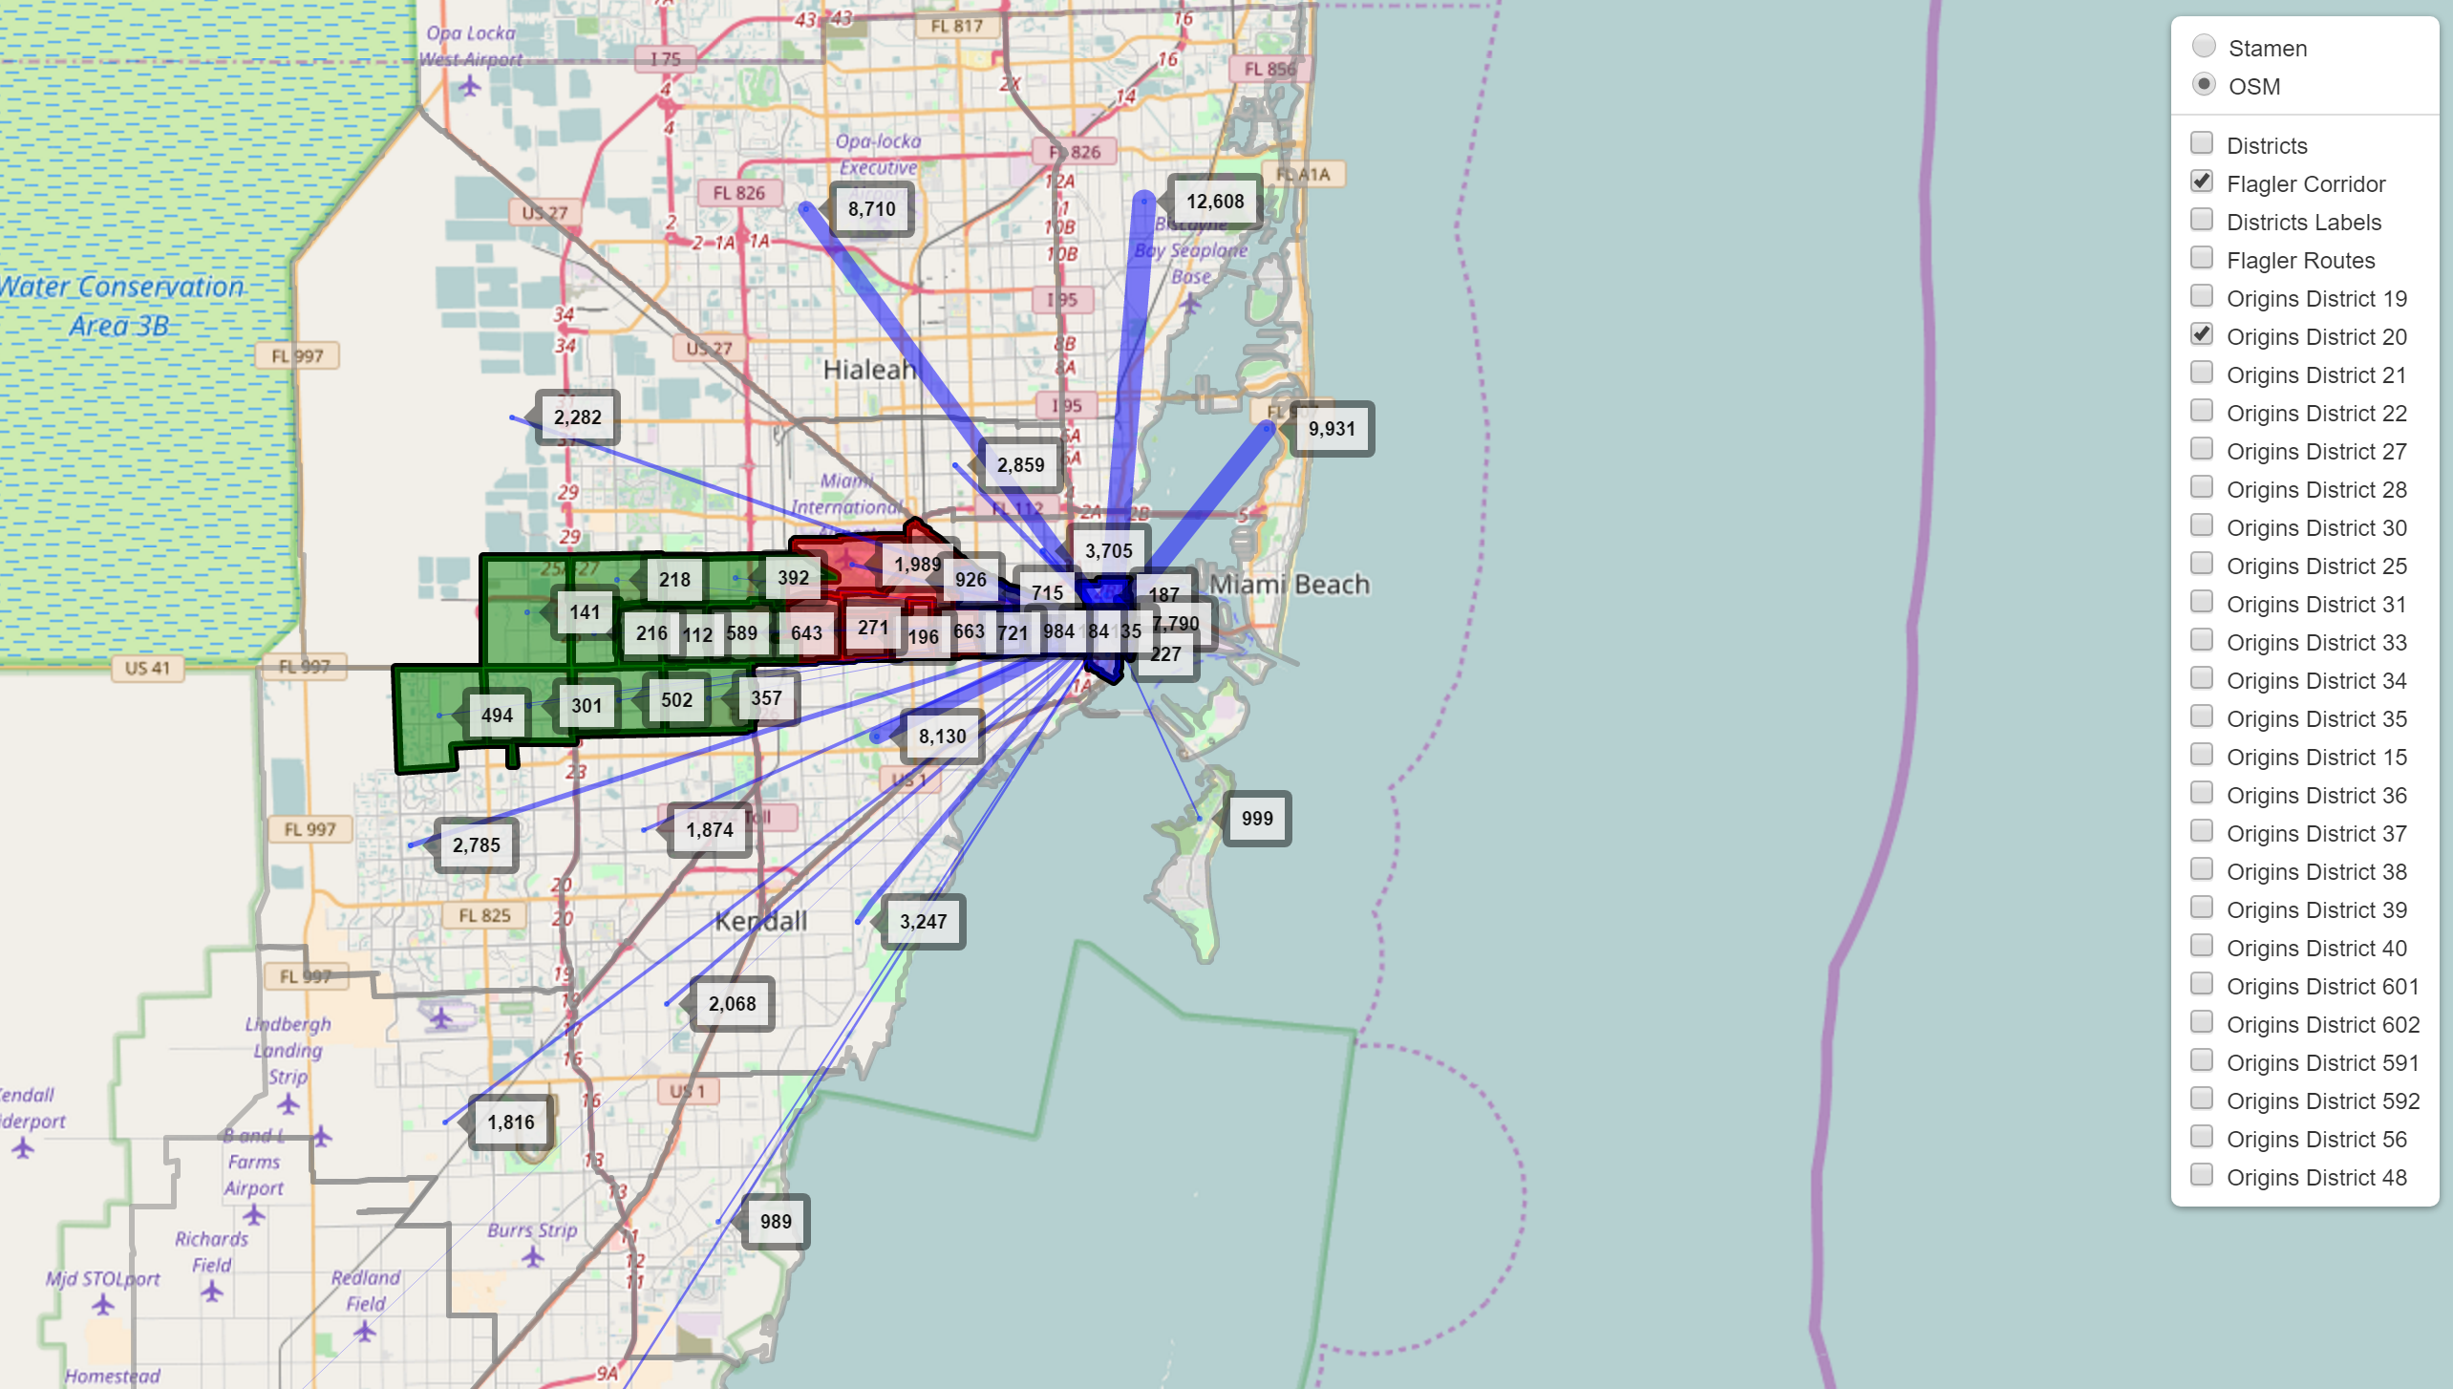
Scalable Maps
Desire lines and corridor districts
Quick and easy to display selected Origins Destinations (check or uncheck)

Slide 22
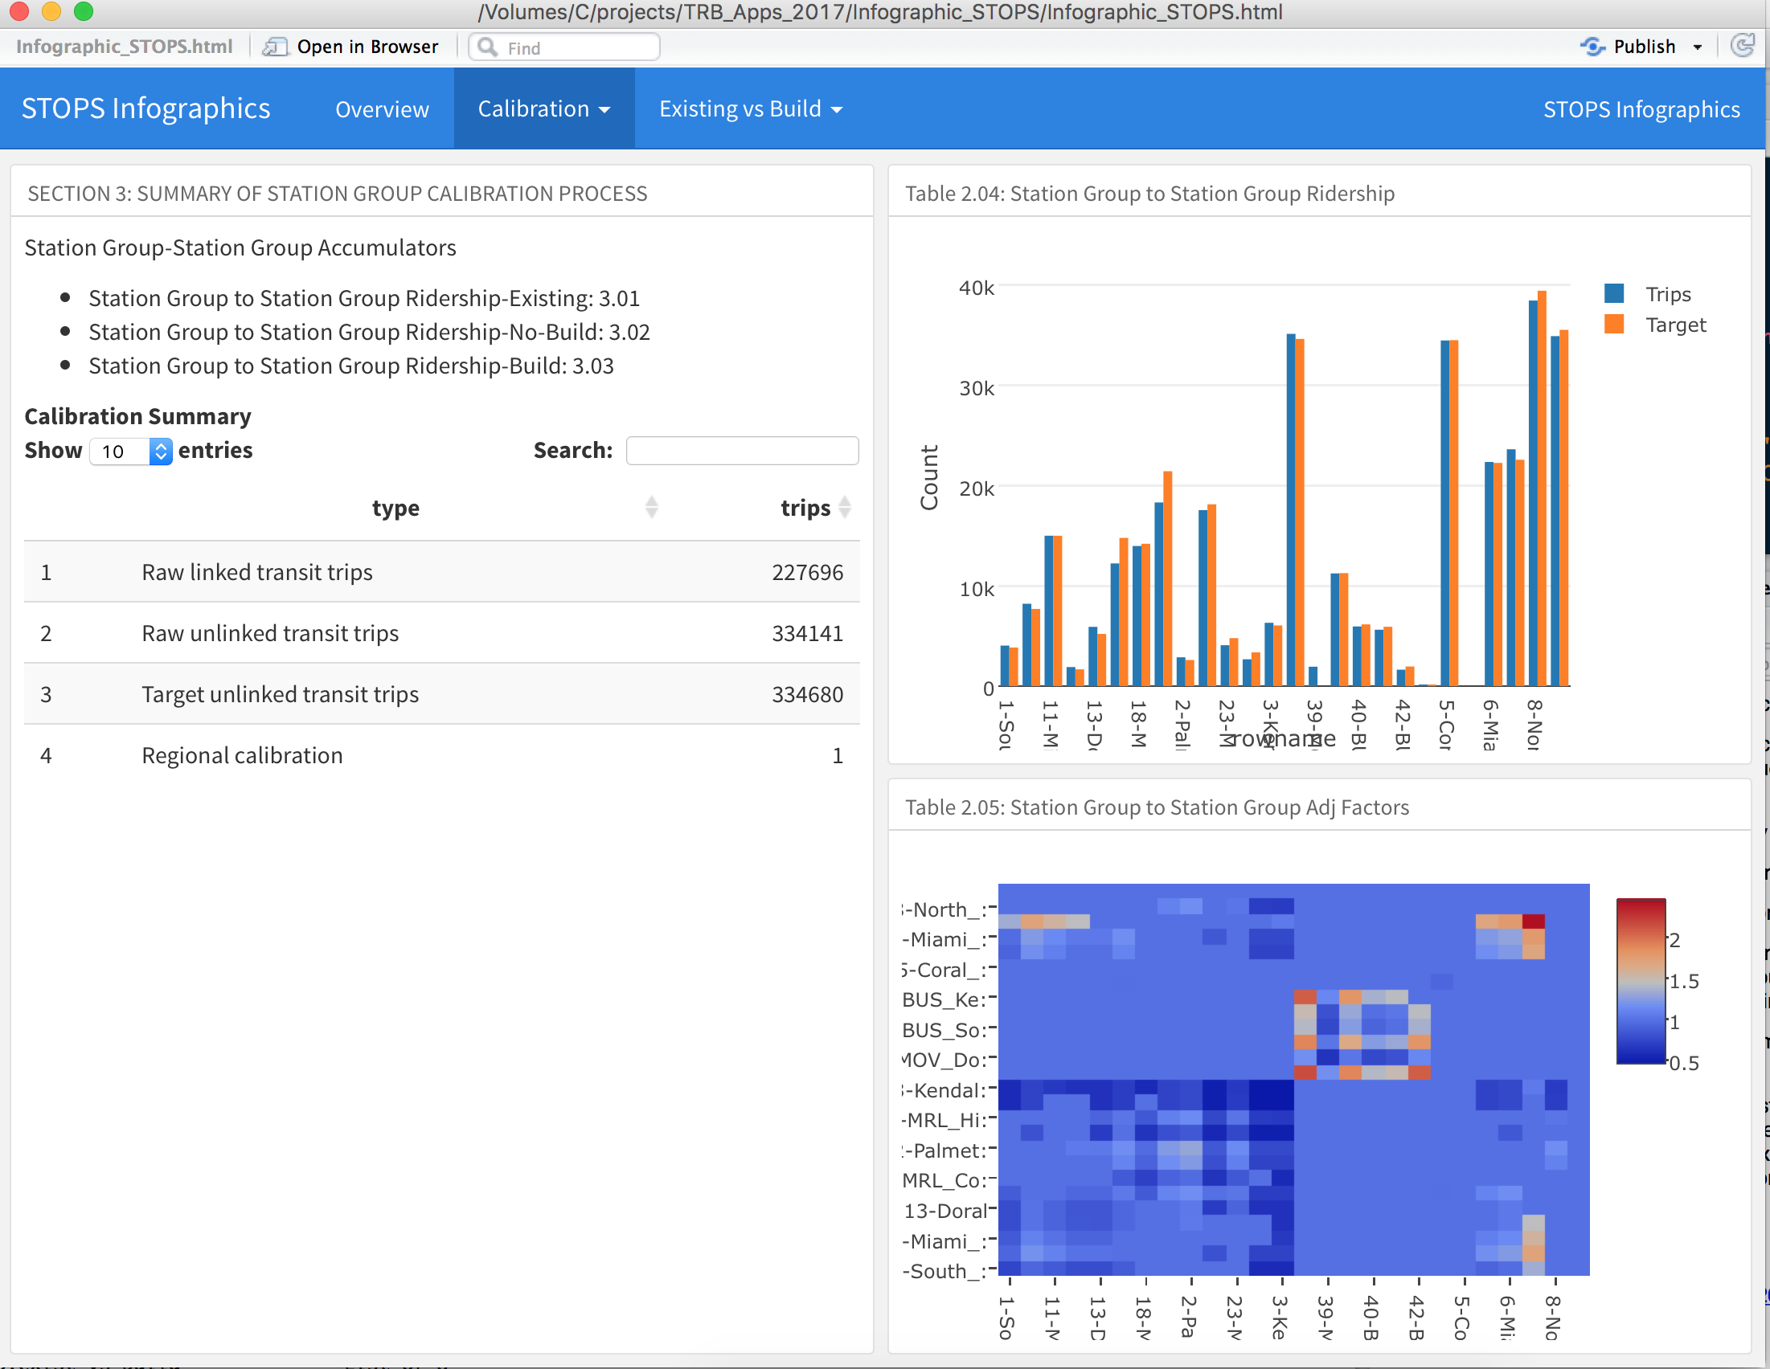
Summary Dashboards
Provides snapshot of key metrics
High level summaries across alternatives or scenarios

Slide 23
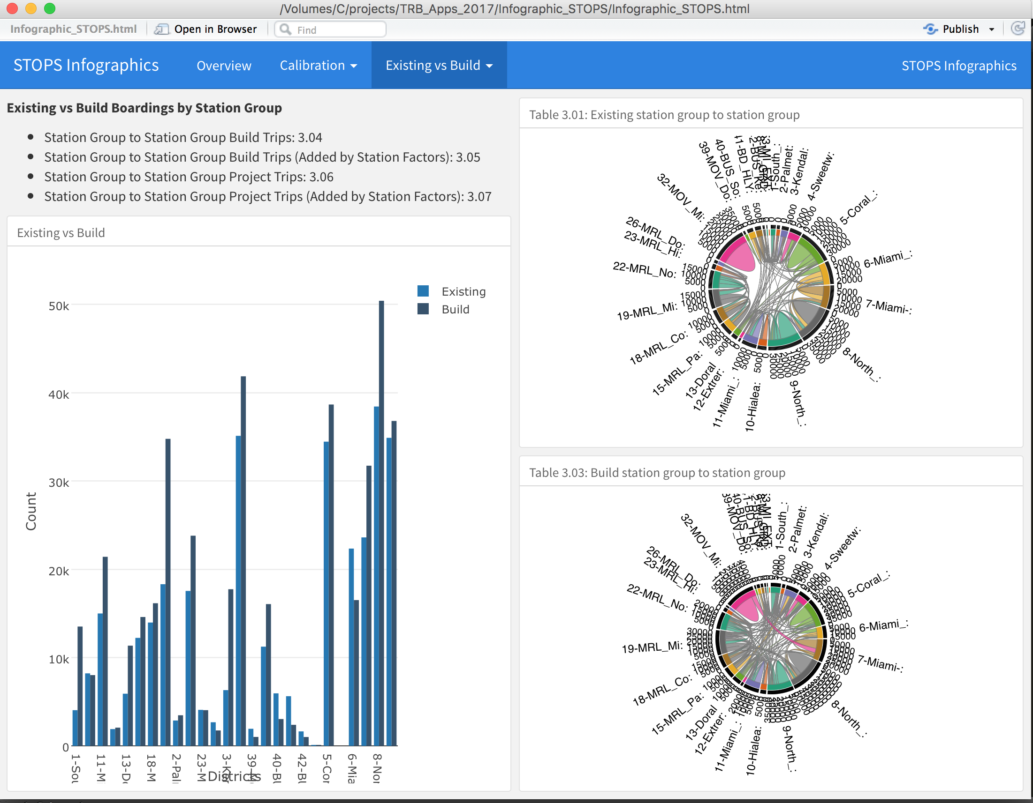
Summary Dashboards
Complex district to district flows can be interactively analyzed

Slide 24
Contact(s)
Amar Sarvepalli
Travel Demand Modeler
Systems Analysis Group
Amar.Sarvepalli@wsp.com
Rhett Fussell ,PE
Senior Technical Principal
Systems Analysis Group
Rhett.Fussell@wsp.com
Questions

